Slide 1
Crowd sourcing of diseases and pests information
PIP2001 Capstone Project
VIVA-VOICE
Batch Number: CSE-G27
Under the Supervision of,
Ms. Rohini A
Assistant Professor
School of Computer Science and Engineering
Presidency University
Roll Number | Student Name
20211CSE0067 20211CSE0112 20211CSE0114 20211CSE0125 | Gaduputi Treteswar Naidu Kasturi Deepak Reddy Masu Teja Darisi Phani Bala Jaswanth
Name of the Program: CSE
Name of the HoD: Dr. Asif Mohammed H.B
Name of the Program Project Coordinator: Mr. Amarnath J.
Name of the School Project Coordinators: Dr. Sampath A K

Slide 2
Introduction
Crowdsourcing has become a perfect approach in many fields; and with the support of collecting disease and pest information, this technology is picking up steam. In this approach, the collective knowledge and participation of a large, distributed group of people from various walks of life are utilized to gather, analyze, and report data on diseases affecting crops, livestock, or human health.
Conventional disease and pest monitoring is expert-based surveillance, though effective, always overdue, and, therefore expensive. Crowdsourcing offers a complementary approach in that it's possible to capture information in real-time from non-experts, such as farmers, community members, and citizen scientists, in images, descriptions as well as geolocated data given the prevalence of smartphones, digital tools, and online platforms to assure ease of reporting any sighting or outbreak.

Slide 3
Literature Survey
[1] He, Y., et al. (2016) conducted a case study in China demonstrating the effectiveness of crowdsourcing in diagnosing plant pests and diseases. Their work highlighted how collective intelligence from farmers and experts improved detection accuracy, emphasizing the potential for scalable implementation in agricultural systems.
[2] Dufour, M., and Poulain, L. (2018) explored leveraging crowdsourcing for plant disease detection, focusing on its application in agricultural systems. The study underlined the role of community participation in creating robust datasets for disease management while addressing technological and infrastructural challenges.
[3] Sarangi, S., et al. (2017) investigated the use of mobile crowdsourcing for disease and pest management among farmers. The study revealed the significance of mobile applications in disseminating timely information and fostering peer-to-peer collaboration for sustainable agricultural practices.
[4] Rosero, E., et al. (2014) proposed a crowdsourcing approach for monitoring invasive pests. Their research demonstrated the efficiency of participatory platforms in tracking pest spread and suggested improvements for real-time data collection and analysis.

Slide 4
[5] Lu, Y., et al. (2015) showcased a crowdsourcing model for identifying diseases and pests in rice crops. The study detailed the integration of mobile technology to facilitate rapid disease detection, paving the way for improved crop management strategies.
[6] Niu, Y., et al. (2019) examined the utility of crowdsourcing data for crop disease identification and forecasting. Their findings highlighted the importance of combining community-driven data with advanced analytics for predictive agricultural solutions.
[7] McCulloch, J., et al. (2013) investigated community contributions to pest and disease management through crowdsourcing. The study emphasized the role of citizen scientists in improving plant health monitoring need for structured training to enhance data reliability.
[8] Ali, H., et al. (2018) focused on small-scale farming and explored the use of crowdsourcing for pest and disease detection. Their research provided insights into how technology-enabled platforms can empower marginal farmers to combat agricultural challenges effectively.

Slide 5
[9] McCallum, S., et al. (2012) analyzed the impact of user engagement on pest control practices using crowdsourced data. The findings revealed a strong correlation between active community participation and improved pest management outcomes, highlighting the importance of user retention strategies.
[10] Guo, Q., et al. (2018) discussed the applications and future perspectives of crowdsourcing for disease diagnosis in agriculture. The study proposed integrating advanced technologies like machine learning and IoT with crowdsourcing platforms to enhance diagnostic capabilities and scalability.

Slide 6
Research Gaps Identified
1. Data Quality and Validation:
Lack of Standardization: Crowdsourced data may lack uniformity in format, terminology, or quality, leading to inconsistencies.
Validation Mechanisms: There is a need for robust systems to validate user-submitted data, ensuring reliability and accuracy.
Noise in Data: Managing irrelevant, duplicate, or erroneous submissions is challenging.

Slide 7
2. User Engagement and Participation:
Incentive Mechanisms: Limited research exists on effective ways to incentivize users to contribute data consistently.
Retention Strategies: Understanding how to maintain long-term user engagement in agricultural communities.
Cultural and Linguistic Barriers: Addressing barriers for farmers in remote or diverse regions who may face language or technological challenges.

Slide 8
3. Technology Limitations:
Image Recognition Accuracy: Improving the accuracy of AI models in diagnosing diseases and pests from user-submitted images.
Scalability: Ensuring platforms can handle large volumes of data and users without compromising performance.
Low-Tech Accessibility: Developing solutions for areas with limited internet access or outdated devices.

Slide 9
4. Integration with Existing Systems:
Lack of Interoperability: Difficulty integrating crowdsourced data with government or private agricultural databases.
Feedback Loops: Limited frameworks to provide actionable insights back to users and institutions based on collected data.

Slide 10
5. Ethical and Privacy Concerns
Data Ownership: Determining ownership of crowdsourced data and ensuring fair usage.
Privacy Risks: Addressing concerns related to geotagged data or identifiable information in submissions.
Bias Mitigation: Preventing biases that could arise due to demographic or regional disparities in data submission.

Slide 11
Proposed Methodology
Develop a mobile application for users (farmers, experts, admins) to report pest or disease occurrences. The app would allow users to submit photos, descriptions of the problem, location data, and additional data like crop type, symptoms, or affected areas.
Provide contributors with user-friendly tutorials, visual guides, and resources to help them identify pests or diseases more accurately.
To address the issue of fake contributors, verification of submissions will be carried out by the admin. By implementing a manual verification process, the system ensures that only accurate and legitimate information is accepted, minimizing the impact of false reports.

Slide 12
Objectives
Develop a User-Friendly Mobile Application
Implement Community Collaboration for Disease Management
Provide Cultivation Tips and Educational Resources
Ensure Multilingual Support for Inclusivity
Enable Real-Time Disease Reporting and Feedback

Slide 13
Implement Community Moderation Features
Optimize Backend Performance Using Firebase
Enhance Agricultural Knowledge and Community Engagement
Encourage Eco-Friendly Practices
Enable Expert Consultation Services

Slide 14
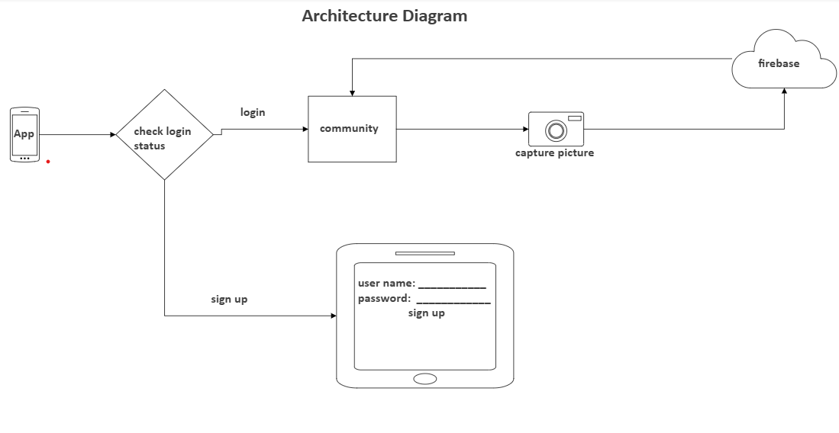
System Design and Implementation
Fig 1. System Architectural Diagram

Slide 15
Components of the Architecture:
Mobile Application (Frontend):
Developed using Android Studio and Java for the user interface and application logic.
Provides features such as disease reporting, viewing community responses, and accessing cultivation tips and videos.
Backend Server:
Firebase is used for data storage, real-time updates, and user authentication. It provides a cloud-based solution that scales easily and handles large amounts of data efficiently.
Database:
Firebase's Firestore is used to store user data, disease reports and responses.

Slide 16
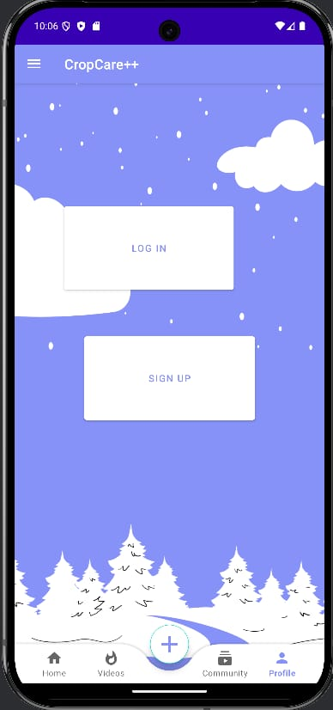
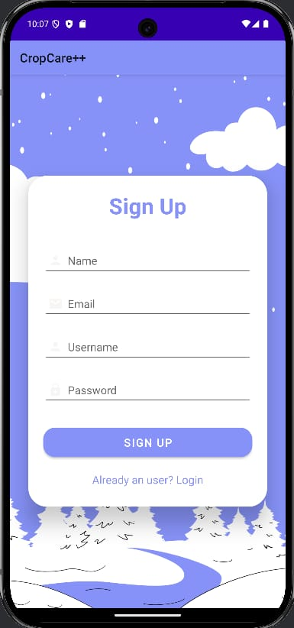
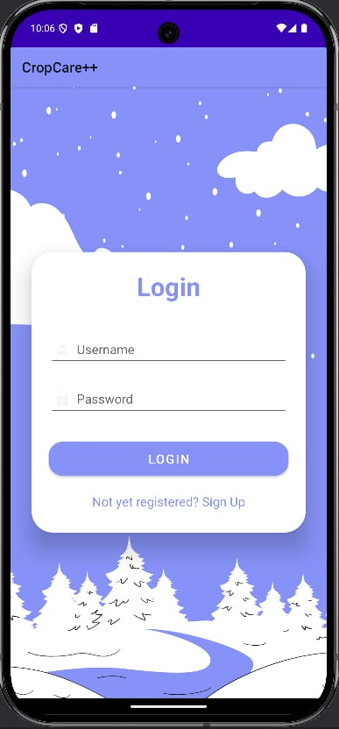
Fig 2. Login and Signup Fig 3. SignUp Page Fig 4. Login Page

Slide 17
User Interface Design
The application will feature a clean, intuitive, and responsive user interface. The key elements of the UI are:
User Registration and Profile Setup:
Simple registration process using email for authentication.
Profile customization, including location, crop types, and preferred language settings.
Disease Reporting Mechanism:
Users can upload images of affected crops along with a description of symptoms.
The system will tag each report for follow-up and categorization, helping in future searches.

Slide 18
Community Feed:
Users can post disease reports, and other users can reply with solutions.
Features such as upvote/downvote will determine the visibility of responses.
Cultivation Tips & Video Content:
A categorized library of cultivation tips and instructional videos on topics like pest management, fertilization, and harvesting.
Video streaming and content delivery is handled through Firebase Storage, ensuring smooth access to educational resources.

Slide 19
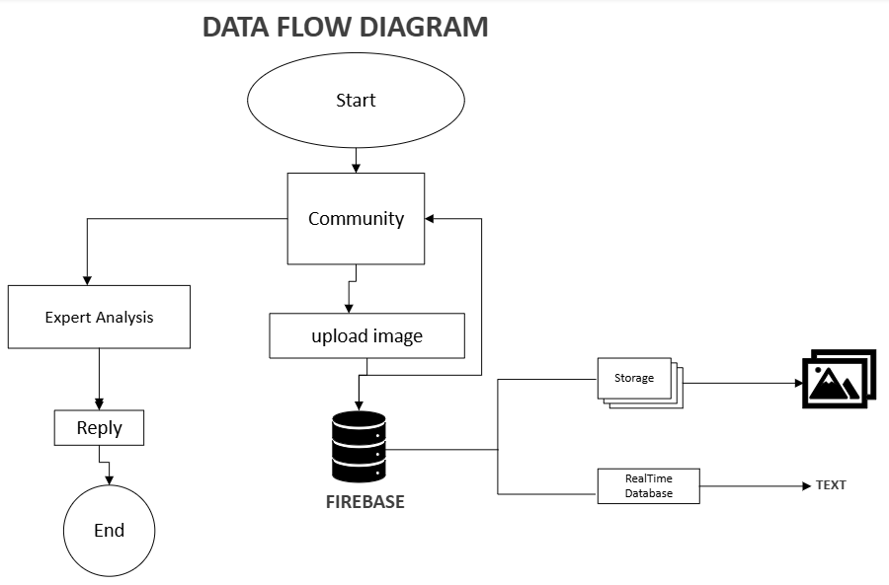
Fig 5. Data Flow Diagram

Slide 20
User Authentication:
Firebase Authentication provides a secure and simple way to manage user logins and profiles using email and password.
Data Management:
Firebase Firestore stores user data, including disease reports, community responses, and user profiles. It also stores cultivation resources like written tips and video content.
Real-Time Updates:
Firebase's real-time database ensures that changes made by one user (e.g., posting a new disease report or response) are immediately reflected for other users. This feature enhances collaboration and ensures up-to-date information.

Slide 21
Moderation & Reputation System:
Implemented a system where users earn points based on the quality of their contributions (e.g., accurate disease solutions).
Flagging and reporting inappropriate content ensures that the community remains helpful and constructive.
Video Streaming:
Short videos related to cultivation practices and disease management are stored in Firebase Storage and can be streamed directly within the app. Videos are optimized for different network conditions to ensure smooth playback.

Slide 22
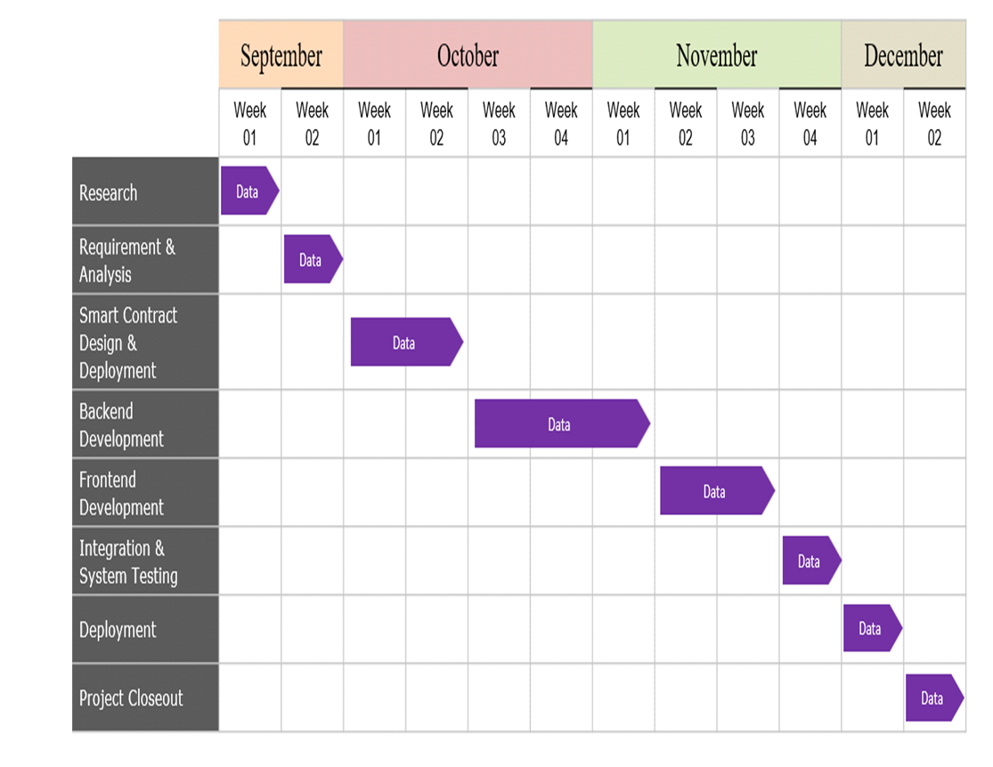
Timeline of Project

Slide 23
Outcomes / Results Obtained
Enhanced Crop Disease Detection
Community Engagement and Collaboration
Accessible Cultivation Resources
Language Inclusivity
Quality Control and Moderation

Slide 24
Improved Pest Management
Knowledge Sharing and Learning
Real-time Disease Tracking and Reporting
Scalability
Sustainable Agricultural Practices
Personalized Recommendations for Farmers

Slide 25
Conclusion
The mobile application developed in this project effectively addresses several critical challenges faced by farmers, with a primary focus on the management of crop diseases and optimizing cultivation practices. By providing a platform that integrates disease reporting, access to educational resources, and fosters community collaboration, the application empowers farmers to make informed decisions about their crops, improving productivity and minimizing losses.
The app's successful implementation of features such as disease reporting with image uploads, community interaction through discussion feeds, and access to cultivation tips has proven to be a valuable resource for bridging the knowledge gap in agriculture. Furthermore, the inclusion of multilingual support has expanded the app’s reach, ensuring that farmers from diverse linguistic and cultural backgrounds can easily access the platform and benefit from its functionalities.

Slide 26
While the app has performed well in its core functionalities, valuable user feedback has highlighted areas for improvement. These include expanding language support to include additional regional languages and incorporating an offline mode to support farmers in areas with unreliable internet connectivity. The challenges faced during the development phase, such as ensuring data accuracy and addressing connectivity issues, have provided a roadmap for future updates and improvements.
One of the key successes of the project is its potential to foster community-driven support, which is crucial for small-scale farmers who often lack direct access to expert advice. The collaborative features, including the upvote/downvote system and expert verification, have successfully engaged users in providing valuable insights and solutions. This sense of community helps ensure that farmers have a reliable resource for disease diagnosis, pest management, and other critical farming information.

Slide 27
References
[1]. He, Y., et al. (2016) ‘Crowdsourcing for Plant Pest and Disease Diagnosis: A Case Study in China’, Computers and Electronics in Agriculture, Vol. 127, pp. 15-22.
[2]. Dufour, M., & Poulain, L. (2018) ‘Leveraging Crowdsourcing to Detect Plant Disease in Agricultural Systems’, Agricultural Systems, Vol. 165, pp. 69-77.
[3]. Sarangi, S., et al. (2017) ‘Mobile Crowdsourcing in Agriculture: A Study on Disease and Pest Management for Farmers’, International Journal of Agricultural Sustainability, Vol. 15, No. 2, pp. 151-164.
[4]. Rosero, E., et al. (2014) ‘A Crowdsourcing Approach for Invasive Pest Monitoring’, PLOS ONE, Vol. 9, No. 12, e113849.
[5]. Lu, Y., et al. (2015) ‘Crowdsourcing in Agriculture: A Case Study of Disease and Pest Identification in Rice Crops’, Computers and Electronics in Agriculture, Vol. 114, pp. 151-157.

Slide 28
[6]. Niu, Y., et al. (2019) ‘Use of Crowdsourcing Data for Crop Disease Identification and Forecasting’, Agricultural and Forest Meteorology, Vol. 271, pp. 64-72.
[7]. McCulloch, J., et al. (2013) ‘Crowdsourcing for Plant Health: An Investigation of Community Contributions to Pest and Disease Management’, Environmental Science & Technology, Vol. 47, No. 22, pp. 13159-13166.
[8]. Ali, H., et al. (2018) ‘Crowdsourcing for Pest and Disease Detection in Small-Scale Farming’, International Journal of Pest Management, Vol. 64, No. 5, pp. 422-431.
[9]. McCallum, S., et al. (2012) ‘Crowdsourced Data for Pest Control: An Investigation into User Engagement and its Impact on Pest Management Practices’, Journal of Pest Science, Vol. 85, No. 3, pp. 281-289.
[10]. Guo, Q., et al. (2018) ‘Crowdsourcing for Disease Diagnosis in Agriculture: Applications and Future Perspectives’, Frontiers in Plant Science, Vol. 9, pp. 1364.

Slide 29
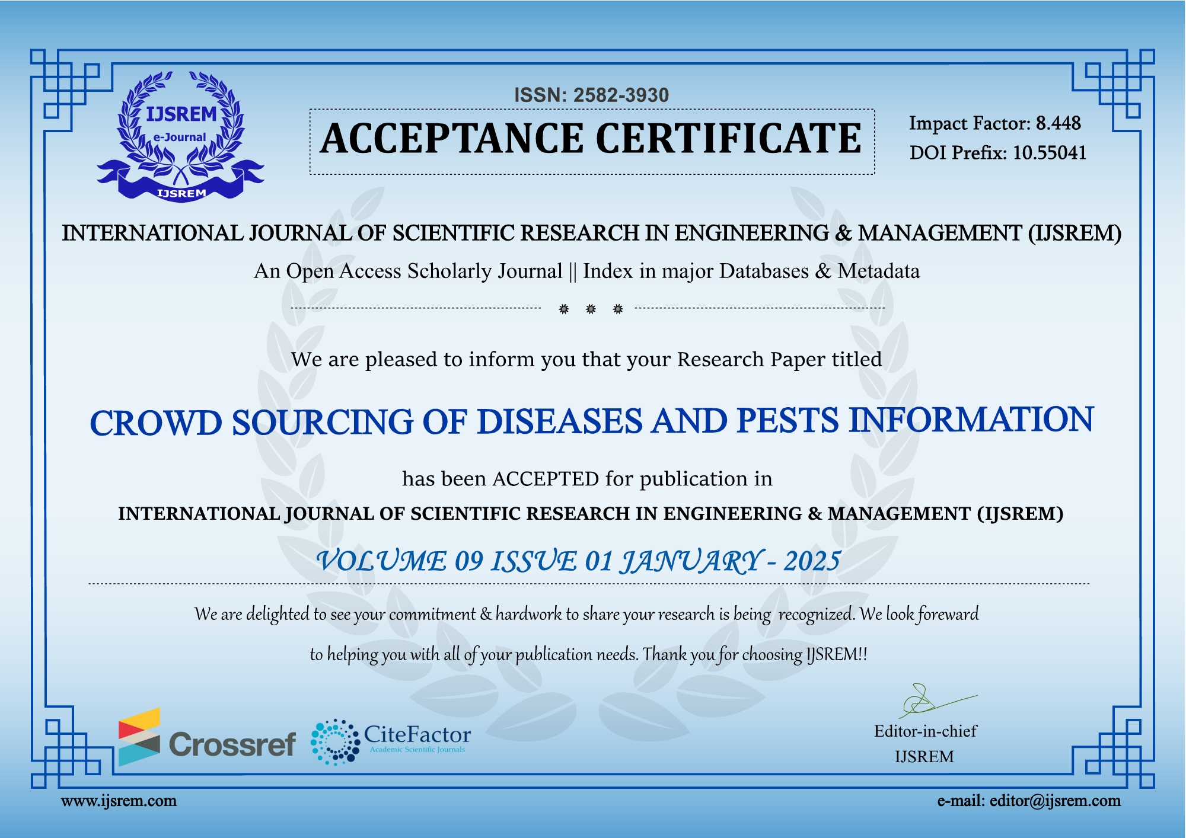
Publication Details

Slide 30
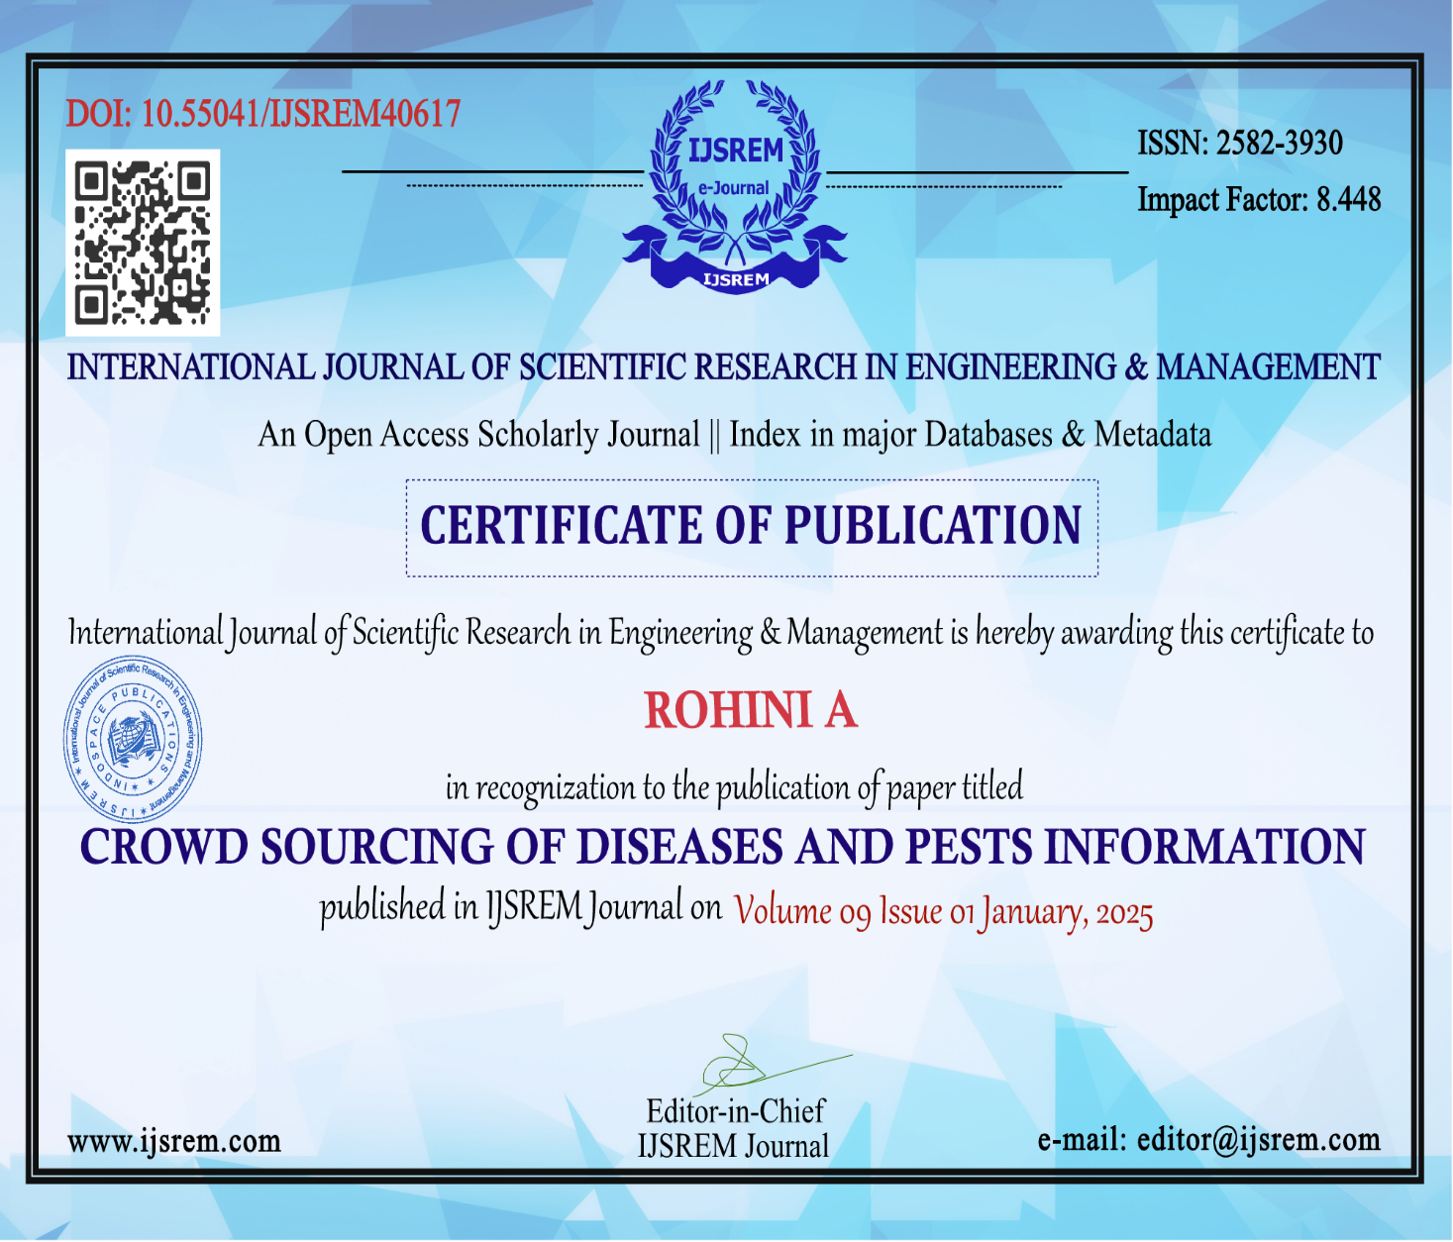

Slide 31
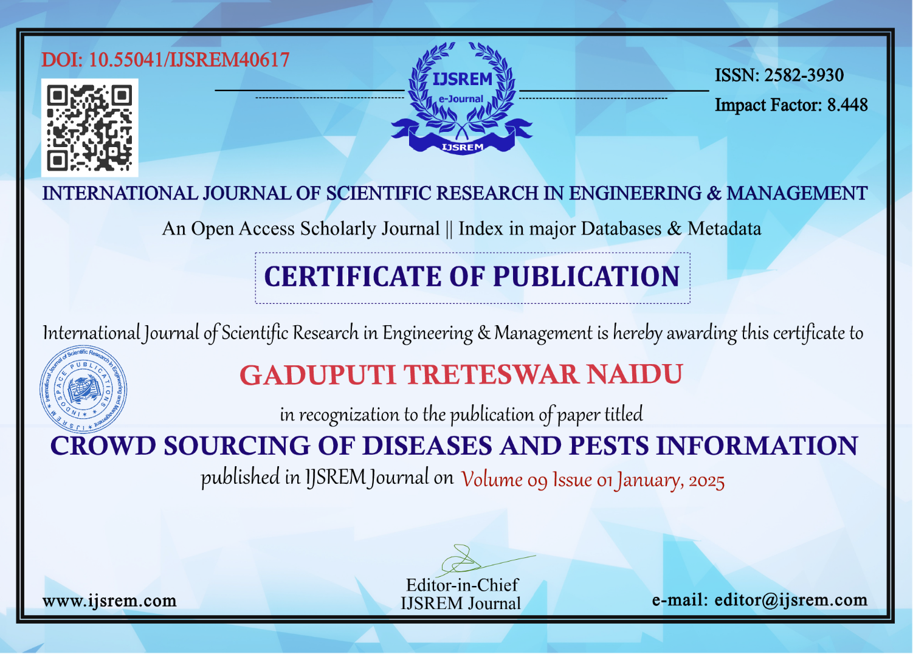

Slide 32
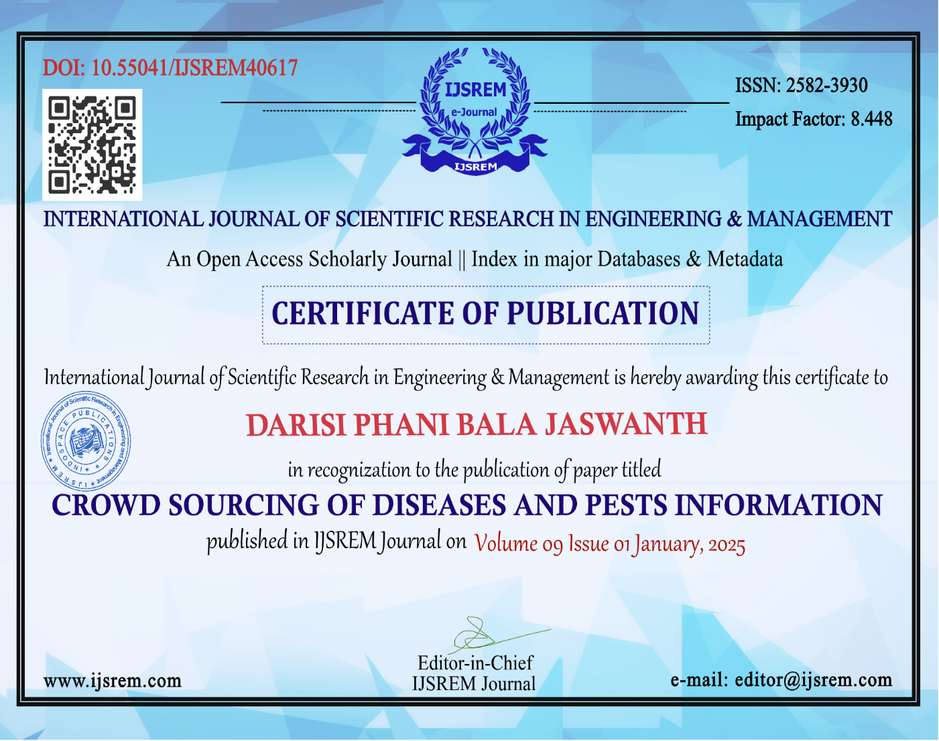

Slide 33


Slide 34
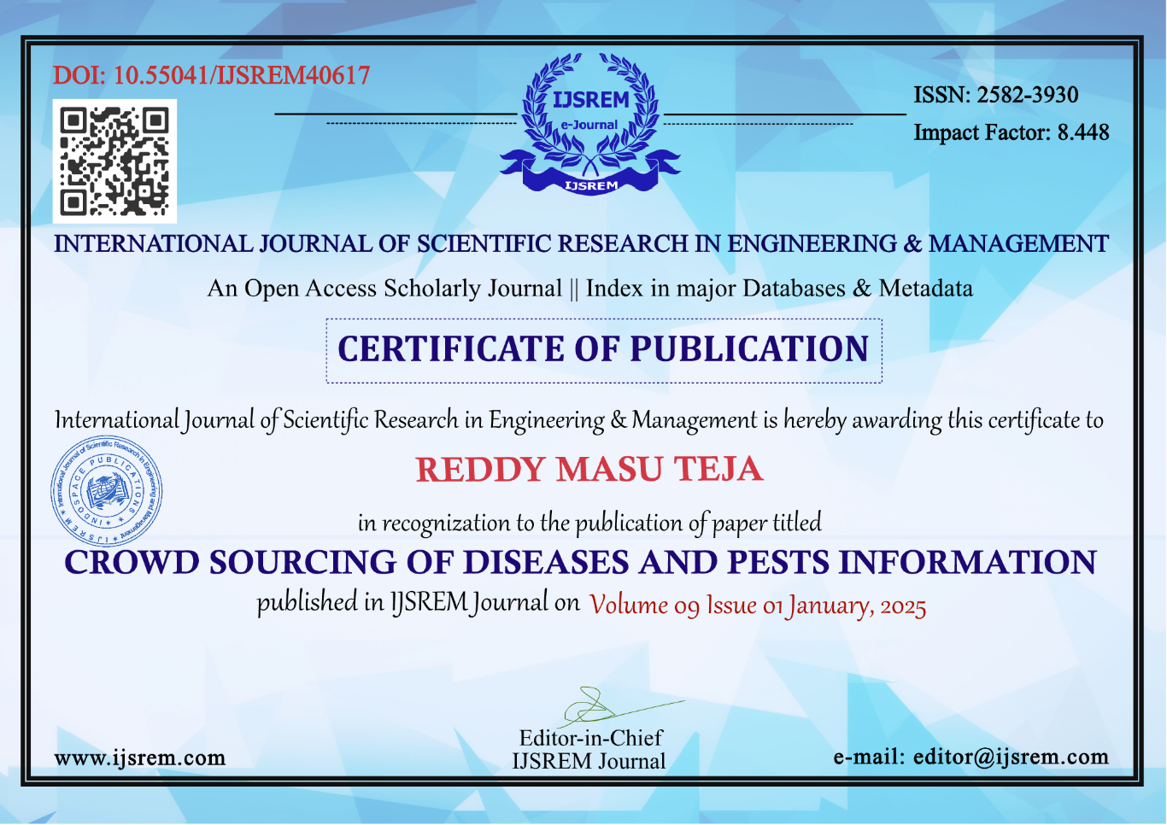

Slide 35
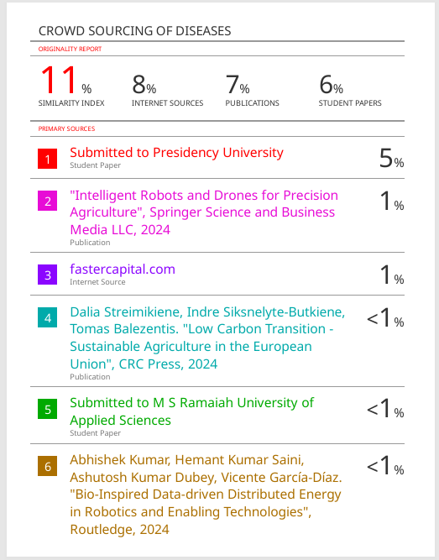
Similarity Index

Slide 36

SUSTAINABLE DEVELOPMENT GOALS
The project work is mapped to SDG 2: Zero Hunger, which focuses on increasing agricultural productivity, optimizing crop recommendations, and making government subsidies more accessible.

Slide 37
Thank You

